Slide 1

Welcome to 2nd Grade
Mrs. McMahan - Virtual
Mrs. Henderson – Virtual
Mrs. Canate – Virtual
Mrs. Echols
Mrs. Napier
Mrs. Stewart

Slide 2
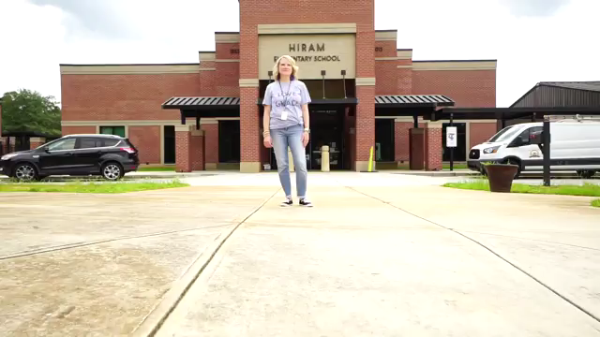
Watch Our Open House Video

Slide 3

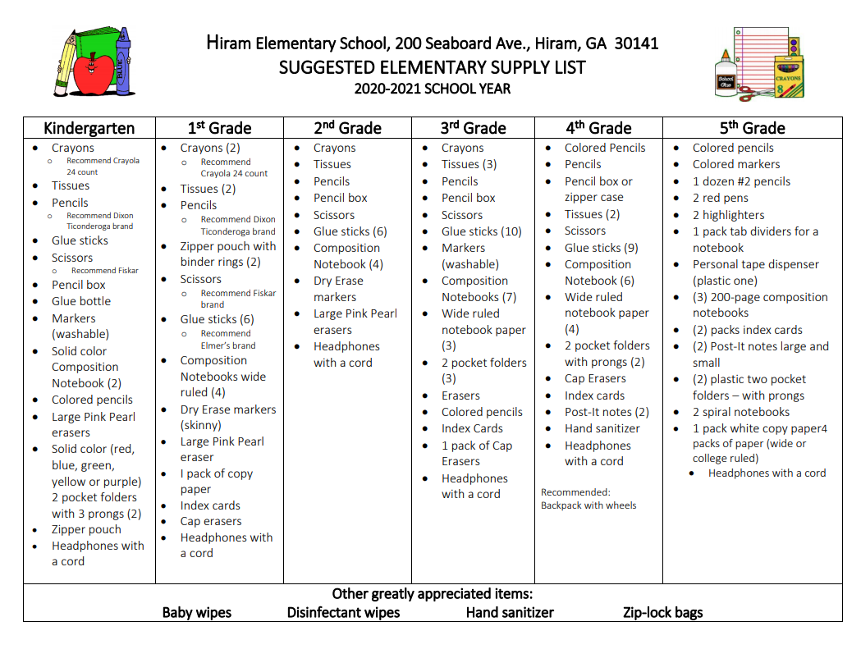
Supply List
***Students will not be sharing supplies this year and will need to have a pencil box to store materials.

Slide 4

BEE Binder & Agenda
Your child will receive 1 BEE binder that includes an agenda.
Please look at it daily for any celebrations, questions, and/or behavior updates.
You are encouraged to communicate through the agenda also. (transportation changes, questions, etc,)
***Please note transportation changes must be sent in writing (agenda/note) with your child. Otherwise, changes must be made in person in the front office by 12 pm. We will not be able to accept transportation changes through email or Class Dojo.

Slide 5
Hornets in Training
In 2nd Grade, we will help our students strengthen in areas other than academics:
Organization:
*Pencils, Papers, Folders, OH MY!
Desks/Cubbies to the Rescue ☺
2. Responsibility:
Your child is responsible for knowing his/her lunch #, turning in any money, parent notes, paperwork, and keeping up with assignments/projects/etc.

Slide 6

We are using Class Dojo to promote being the Best Hiram Hornets we can be!
Students will earn points for following the rules and being great role models to others.
Students can also lose points based on poor choices.
We highly encourage you to download the app and sign up to see how your child is doing daily. You can also send messages directly to your child’s teacher.
See Your Child’s Teacher for More Information

Slide 7
Homework/Newsletters
Your child will have weekly homework unless you are notified.
All homework and newsletters this year will be digital unless otherwise requested. Both will be available on your child’s Canvas page.
Please help your child when needed and find time to listen and/or read with your child nightly.

Slide 8
Bookworms Reading
Bookworms is a researched based reading program designed to boost literacy.
Three Components:
Shared Reading: builds fluency, vocabulary, and comprehension skills
Interactive Read Alouds: increases comprehension, vocabulary, and sentence structure
Differentiated Instruction: data driven, targets specific needs of students

Slide 9
Fluency Rates (Dibels)
2nd grade uses Dibels as our fluency scale for noting on the report card your child’s progress in reading towards the end of grade level proficiency of 90 words per minute.
The passages reflect a progression of difficulty that increase throughout the school year.

Slide 10
Bookworms Writing
3 Types of Writing are assessed in 2nd grade.
Narrative
Informational
Opinion
Phonics Focus
Spelling instruction is taught through the phonics portion of Shared Reading.
Learning will be assessed through writing.

Slide 11
Math Workshop
Lesson Cycle
*Mini-Lesson – The teacher will present the lesson focus for the day.
*Work Time – Students will be working together to solve word problems in their math journals.
*Closing – The closing is student led.
Math Workshop Notebooks are a resource for the students to be able to use when needed.

Slide 12
Math Fact Fluency
Students should know the sums of two single digit numbers automatically by the end of 2nd grade.
Sites to visit for online practice at home: http://www.factmonster.com/math/flashcards.html
http://www.abcya.com/math_facts_game.htm

Slide 13
Anchor Charts
Anchor Charts are created in all academic areas as a resource for the students to use when needed.
Examples of anchor charts are available on our 2nd grade website and on Class Dojo.

Slide 14
Graded Papers
Graded papers will be sent home throughout the year. Please go over these papers with your child. This is a way to check on your child’s progress at school and help your child understand their strengths and areas for improvement.
Grading in 2nd Grade:
Level 1: Limited or minimum progress toward the mastery of the term content/standard.
Level 2: Progressing toward mastery of the term content/standard.
Level 3: Demonstrates mastery of the term content/standard.
Level 4: Exceeds mastery of the term content/standard.
Not all standards lend themselves to a Level 4.
Example: Correctly identifies compound words and
contractions.

Slide 15
Progress Reports/Report Cards
All grades will be accessed digitally this year.
Parents must have a Parent Portal account.
Please click the link below to set up a Parent Portal account.
https://www.paulding.k12.ga.us/Page/27217

Slide 16
Specials
Specials Schedules are in BEE Books
Please make sure your child wears tennis shoes on PE days. If they do not wear appropriate shoes, they sit and do Health work out of a book.
Specials Time: 10:40-11:25

Slide 17
Points of Interest
Helpful Information for Parents about the Georgia Standards of Excellence: https://www.georgiastandards.org/Pages/Parents.aspx
Explore our grade level’s website for everything you need to know about 2nd grade! ☺

Slide 18
Thank You for ALL You Do!
We appreciate our students and their families for all the support. Please contact us if you have any questions. ☺
Rebekah Echols: rechols@paulding.k12.ga.us
Kim Henderson: khenderson@paulding.k12.ga.us
Laura Canate: lcanate@Paulding.k12.ga.us
Brandi McMahan: bmcmahan@Paulding.k12.ga.us
Sarah Napier: snapier@paulding.k12.ga.us
Nikki Stewart: jstewart@paulding.k12.ga.us

